Slide 1
Heaps
Binary heaps
d-heaps
Leftist heaps
Skew heaps
Binomial heaps

Slide 2
(Binary) Heaps
Proposed by J. Williams in 1964.
A heap is a data ordered binary tree satisfies the following 2 requirements:
(The structural requirement) The tree is complete.
(The order requirement) The value of a node is greater than the value of its parent.
It’s a data structure designed for finding smallest/largest element.
2
2
2
20
6
20
8
20
6
21
100
7
9
12
4
10
40
21
100
7
9
23
30
13
39
30
A heap
Not a heap
Not a heap

Slide 3
Insertion
Insert the new key at the left most available position of the top level.
Perform a sift up (percolate up) operation from the new key, ie. keep swapping the new key with its parent, until its parent is smaller or there is no parent.
The time is O(h) which is O(log₂n)
2
2
2
15
6
20
6
20
6
21
20
7
9
21
15
7
9
21
100
7
9
23
30
100
23
30
100
23
30
15
Swap 15 & 20
Swap 15 & 100
Notes:
‹#›

Slide 4
Delete the minimum
Replace the min (the root) with the right most node of the top level.
Remove the right most node.
Perform a heapify(sift down) operation from the root. That is, keep swapping the node with its smaller child until the smaller child is bigger or no more child.
The time is O(h) = O(log₂n).
6
6
30
2
7
20
30
20
6
20
6
30
9
21
100
7
9
21
100
7
9
21
100
7
9
23
23
23
30
Swap 30 & 7
Replace 2 with 30
Remove the original 30
Swap 30 & 6
Notes:
‹#›

Slide 5
decreaseKey/increaseKey
The decreaseKey/increaseKey operation lowers/increases the value of the item at a position, say p.
To maintain the heap order, perform a sift up/sift down operation from p.
The time is O(h) = O(log₂n).
2
2
20
6
10
6
21
100
7
9
20
100
7
9
×
23
30
21
30
10
Notes:
‹#›

Slide 6
Representation
Since the tree is complete, array based representation is most efficient.
2
20
6
21
100
7
9
23
30
1
0
2
1
2
3
2
20
6
3
4
5
6
7
4
21
100
7
9
5
8
9
6
23
30
7
8
9
9
size

Slide 7
Insertion Revisit
2
2
2
15
6
20
6
20
6
21
20
7
9
21
15
7
9
21
100
7
9
23
30
100
23
30
100
23
30
15
2
15
6
21
20
7
9
23
30
100
2
20
6
21
100
7
9
23
30
15
0
2
20
6
21
15
7
9
23
30
100
0
0
1
Swap 15 & 20
Swap 15 & 100
1
1
2
2
2
3
3
3
4
Parent =5/2=2
4
4
5
5
5
6
6
6
7
7
7
8
Parent =10/2=5
8
8
9
9
9
size
10
10
10
10
Notes:
‹#›

Slide 8
Deletion Revisit
6
6
30
2
7
20
30
20
6
20
6
30
9
21
100
7
9
21
100
7
9
21
100
7
9
Swap 30 & 7
23
23
23
30
Swap 30 & 6
6
20
7
21
100
30
9
23
30
6
20
30
21
100
7
9
23
30
Replace 2 with 30
Remove the original 30
0
0
30
20
6
21
100
7
9
23
30
2
20
6
21
100
7
9
23
30
0
0
1
1
1
1
2
2
lt =1*2=2
Rt=2+1=3
2
2
3
lt =3*2=6
Rt=6+1=7
3
3
3
4
4
4
4
5
5
5
5
6
6
6
6
7
size
7
size
7
size
7
8
8
8
8
8
8
8
size
9
9
9
9
9
Notes:
‹#›

Slide 9
Heapsort
Basic Idea:
Use “heapify” in bottom-up manner, convert the array into a heap.
Then successively remove the minimum element from the heap and move it to the last position in the sorted array.
Time complexity
Converting an array into a heap takes O(n).
Each of the n-1 deletion takes time O(lg n).
Total time is O(n lg n)

Slide 10
Convert an array into a heap
Algorithm
for (i=n/2; i>0; --i) {
j = i;
while(2*j<=n) {
smaller = 2*j;
if (smaller+1<=n &&
a[smaller+1]<a[smaller])
smaller = smaller+1;
if (a[smaller]<a[j]) {
swap(j, smaller);
j = smaller;
}
}
}
Initialize smaller to the left child
If the right child exist and smaller than the left child
Heapify entry i
7
6
5
4
3
2
1

Slide 11
Complexity analysis
One node travels down h levels during percolateDown, 2 nodes (h –1) levels, 4 nodes (h –2) levels, etc.
The total number of levels traveled is
h + 2(h –1) + 4 (h –2) + …+ 2^{h –1}(h – (h – 1))
= 2^{h –1}(1 + 2(1/2) + 3(1/2)² + 4(1/2)³ + …) ≤ 2n,
because 2^{h –1} < n/2 since h ≤ lg n, and the infinite series 1 + 2x + 3x² + … = 1/(1 –x)² when |x| < 1. Thus, the time complexity of heapify is O(n).

Slide 12
Priority Queues
A priority queue is a data structure supporting the following two operations:
Add an element to the queue with an associated priority.
Remove the element with the highest priority from the queue, and return it.
 | insert | delete
Sorted array | O(n) | O(n)/O(1)
Sorted linked list | O(n) | O(1)
Binary heap | O(lg n) | O(lg n)

Slide 13
d-heaps
Same as binary heaps, except d children instead of 2.
array implementation
To insert an element: O(log_{d} N)
To delete an element: O(d log_{d} N)
10
16
12
80
45
27
78
23
95
15
90
95
87
size
54
59
15
1
2
3
4
5
6
7
8
9
10
11
12
13
14
15
16
10 | 16 | 12 | 80 | 45 | 27 | 78 | 23 | 95 | 15 | 90 | 95 | 87 | 54 | 59
Parent(i ) is ⎡(i-1)/d⎤.
The indices of the children of i are in the range of
[d*(i-1)+2 .. d*i + 1].

Slide 14
Leftist Heaps
Proposed by C. A. Crane in 1972.
If x is a node in a binary tree, the null path length of x, npl(x), is defined to be the length of the shortest path from x to a node without two children.
The npl of a node with 1 or 0 child is 0 and npl(null) is –1.
npl(x)=min{npl(x.left),npl(x.right)}+1.
A binary tree is leftist, if npl(x.left)≥npl(x.right) for every x.
The right path of a leftist tree is the path from the root to the rightmost node without two children.
This is a shortest path from the root to a node without two children and has a length at most lg n.
A leftist heap is a leftist tree in heap order.
1
1
1
0
3
6
1
0
0
-1
4
7
9
0
0
-1
-1
-1
-1
-1
8
-1
-1
5
-1

Slide 15
Merging Leftist Heaps
merge right paths according to key values
1
1
1
1
0
1
13
6
1
2
1
0
0
-1
13
2
1
0
1
0
14
17
9
6
0
0
-1
-1
-1
-1
14
17
3
0
0
-1
1
0
0
1
-1
28
-1
-1
15
-1
28
-1
15
4
7
9
16
2
-1
-1
-1
0
0
-1
-1
-1
-1
0
0
1
2
1
8
5
19
29
-1
-1
-1
-1
-1
-1
-1
-1
3
16
1
0
0
0
4
7
19
29
2
0
0
-1
-1
-1
-1
-1
-1
1
-1
8
-1
-1
5
-1
2
1
2
1
13
1
1
0
3
6
14
17
1
0
1
0
0
0
-1
-1
update npl’s and swap subtrees on right path to restore leftist property
4
7
-1
16
9
28
-1
15
-1
-1
-1
-1
-1
-1
0
0
0
0
8
-1
5
19
29
-1
-1
-1
-1
-1
-1
-1

Slide 16
To insert an element
Treat the new element as a single element heap.
Merge the original heap with the single element heap.
O(lg n)
Example, to insert 2.
1
1
1
1
0
1
1
0
0
3
2
3
6
2
1
0
-1
0
1
0
0
-1
-1
-1
6
4
7
-1
4
7
9
0
0
-1
-1
0
0
0
-1
-1
-1
-1
9
-1
8
-1
-1
5
-1
-1
-1
-1
8
-1
-1
5
-1
1
1
1
0
3
2
1
0
0
-1
4
7
6
0
0
-1
-1
0
-1
-1
8
5
9
-1
-1
-1
-1
-1

Slide 17
To delete the min
Remove the root.
Merge the two subtrees.
O(lg n).
1
×
1
1
0
3
6
1
0
0
-1
4
7
9
0
0
-1
-1
-1
-1
-1
8
-1
-1
5
-1
1
0
2
3
6
3
1
1
0
0
-1
1
4
7
9
4
6
0
0
-1
-1
-1
-1
0
0
0
0
8
5
8
5
9
7
-1
-1
-1
-1
-1
-1
-1
-1
-1
-1
-1
-1

Slide 18
Skew Heaps
Proposed by D. D. Sleator and R. E. Tarjan in 1985.
Similar to leftist heaps.
No npl values stored.
Swap left and right subtrees of all nodes on rightmost path rather than just when npl(l(x)) < npl(r(x)).
Amortized complexity of each operation is O(log n)

Slide 19
Binomial Trees
Binomial tree.
Recursive definition:
B₀:
B_{k}:
B_{k-1}
B_{k-1}
Examples:
B₀
B₁
B₂
B₃
B₄

Slide 20
Binomial Trees
Useful properties of order k binomial tree B_{k}.
Number of nodes = 2^{k}.
Height = k+1.
Degree of root = k.
Deleting root yields binomial trees B_{k-1}, … , B₀.
B₀
B₁
B₂
B₃
B₄

Slide 21

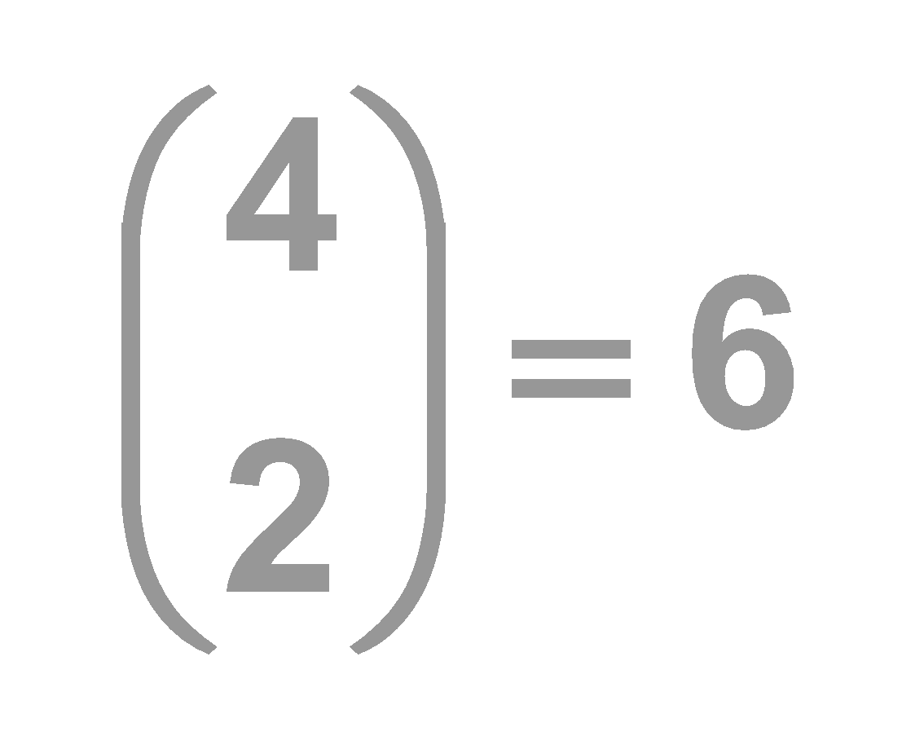
Binomial Trees
A property useful for naming the data structure.
B_{k} has nodes at level i.
level 0
level 1
level 2
level 3
level 4
B₄

Slide 22
Binomial Heaps
Proposed by J. Vuillemin in 1978.
A sequence of binomial trees that satisfy binomial heap property.
Each tree is min-heap ordered.
For each k, 0 or 1 binomial tree of order k.
3
18
6
9
21
16
96
37
B₀
40
60
10
24
65
67
B₁
88
46
70
33
90
B₄

Slide 23
Binomial Heap: Implementation
Implementation.
Represent trees using left-child, next sibling pointers.
two links per node (leftChild, nextSibling)
Roots of trees are stored in an array
degrees of trees strictly decreasing from right to left.
roots
6
3
18
6
3
18
leftChild
29
10
44
37
29
37
leftChild
nextSibling
48
31
17
48
10
Actual representation
50
31
17
44
Binomial Heap
50

Slide 24
Binomial Heap: Properties
Properties of N-node binomial heap.
Min key contained in roots of B₀, B₁, . . . , B_{k}.
Contains binomial tree B_{i} iff b_{i} = 1 where b_{n}⋅ b₂b₁b₀ is binary representation of n.
At most ⎣log₂ n⎦+1 binomial trees.
Height ≤ ⎣log₂ n⎦+1.
6
3
18
9
21
16
96
37
B₀
40
60
10
24
65
67
B₁
B₄
88
46
70
33
N = 19 binary = 10011
# trees = 3 height = 5
90

Slide 25
Binomial Heap: Union
Create heap H that is union of heaps H₁ and H₂.
Easy, if H₁ and H₂ are each order k binomial trees.
connect roots of H₁ and H₂.
choose smaller key to be root of H
6
8
29
10
44
30
23
22
48
31
17
45
32
24
50
55
H₁
H₂

Slide 26
Binomial Heap: Union
6
3
18
8
29
10
44
37
30
23
22
48
31
17
H₁
15
7
12
45
32
24
50
+
28
33
25
55
H₂
41
Merge 2 B₀ into 1 B₁
Merge 2 B₁ into 1 B₂
Merge 2 B₂ into 1 B₄
1
1
1
1
0
0
1
1
19
+
0
0
1
1
1
7
1
1
0
1
0
26

Slide 27
Binomial Heap: Union
3
3
12
15
7
37
7
37
18
28
33
25
25
6
41
3
18
8
29
10
44
37
30
23
22
48
31
17
15
7
12
45
32
24
50
25
28
33
+
55
41
6
3
12
8
29
10
44
15
7
37
18
30
23
22
48
31
17
28
33
25
45
32
24
50
41
55

Slide 28
Binomial Heap: Union
Create heap H that is union of heaps H₁ and H₂.
Analogous to binary addition.
Running time. O(log n)
Proportional to number of trees in root lists ≤ 2( ⎣log₂ n⎦ + 1).
1
1
1

Slide 29
Binomial Heap: Delete Min
Delete node with minimum key in binomial heap H.
Find root x with min key in root list of H, and delete
H' ← broken binomial trees
H ← Union(H')
Running time. O(log n)
×
3
6
18
8
29
10
44
37
30
23
22
48
31
17
45
32
24
50
55

Slide 30
Binomial Heap: Delete Min conti.
8
29
10
44
6
18
30
23
22
48
31
17
37
45
32
24
50
55
6
18
8
29
10
37
44
30
23
22
48
31
17
45
32
24
50
55

Slide 31
Binomial Heap: Insert
Insert a new node x into binomial heap H.
H' ← MakeHeap(x)
H ← Union(H', H)
Running time. O(log n)
3
6
18
x
8
29
10
44
37
30
23
22
48
31
17
H'
H
45
32
24
50
55

Slide 32
Homework
Convert the following array into a heap.
Delete 10 from the heap created in 1).
Insert 1, 2, 3, 4, 5, 6, 7, 8, 9, 10, 11, 12, 13 into an empty leftist heap.
Delete 1 from the leftist heap created in 3).
Insert 1, 2, 3, 4, 5, 6, 7, 8, 9, 10, 11, 12, 13 into an empty binomial queue.
Delete 1 from the binomial queue created in 5).
1
2
3
4
5
6
7
8
9
10
11
12
13
14
15
16
10 | 16 | 12 | 80 | 45 | 27 | 78 | 23 | 95 | 15 | 90 | 95 | 87 | 54 | 59

